Slide 1
Social Turing Tests: Crowdsourcing Sybil Detection
Gang Wang, Manish Mohanlal, Christo Wilson, Xiao Wang
Miriam Metzger, Haitao Zheng and Ben Y. Zhao
Computer Science Department, UC Santa Barbara.
gangw@cs.ucsb.edu

Slide 2
Sybil In Online Social Networks (OSNs)
Sybil (sɪbəl): fake identities controlled by attackers
Friendship is a pre-cursor to other malicious activities
Does not include benign fakes (secondary accounts)
Research has identified malicious Sybils on OSNs
Twitter [CCS 2010]
Facebook [IMC 2010]
Renren [IMC 2011], Tuenti [NSDI 2012]

Slide 3
Real-world Impact of Sybil (Twitter)
900K
800K
700K
4,000 new followers/day
July 21st
Followers
100,000 new followers in 1 day
Jul-4 Jul-8 Jul-12 Jul-16 Jul-20 Jul-24 Jul-28 Aug-1
Russian political protests on Twitter (2011)
25,000 Sybils sent 440,000 tweets
Drown out the genuine tweets from protesters

Slide 4
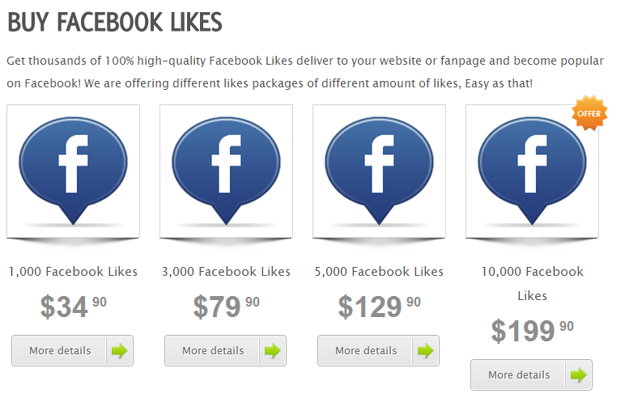
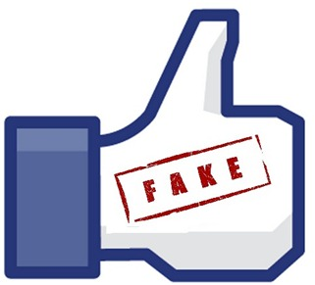
Security Threats of Sybil (Facebook)
Large Sybil population on Facebook
August 2012: 83 million (8.7%)
Sybils are used to:
Share or Send Spam
Theft of user’s personal information
Fake like and click fraud
Malicious URL
50 likes per dollar

Slide 5
Community-based Sybil Detectors
Prior work on Sybil detectors
SybilGuard [SIGCOMM’06], SybilLimit [Oakland '08], SybilInfer [NDSS’09]
Key assumption: Sybils form tight-knit communities
Sybils have difficulty “friending” normal users?

Slide 6
Do Sybils Form Sybil Communities?
5
Measurement study on Sybils in the wild [IMC’11]
Study Sybils in Renren (Chinese Facebook)
Ground-truth data on 560K Sybils collected over 3 years
Sybil components: sub-graphs of connected Sybils
Sybil components are internally sparse
Not amenable to community detection
New Sybil detection system is needed

Slide 7
Detect Sybils without Graphs
Anecdotal evidence that people can spot Sybil profiles
75% of friend requests from Sybils are rejected
Human intuition detects even slight inconsistencies in Sybil profiles
Idea: build a crowdsourced Sybil detector
Focus on user profiles
Leverage human intelligence and intuition
Open Questions
How accurate are users?
What factors affect detection accuracy?
How can we make crowdsourced Sybil detection cost effective?

Slide 8
Outline
Introduction
User Study
Feasibility Experiment
Accuracy Analysis
Factors Impacting User Accuracy
Scalable Sybil Detection System
Conclusion
Details in Paper

Slide 9
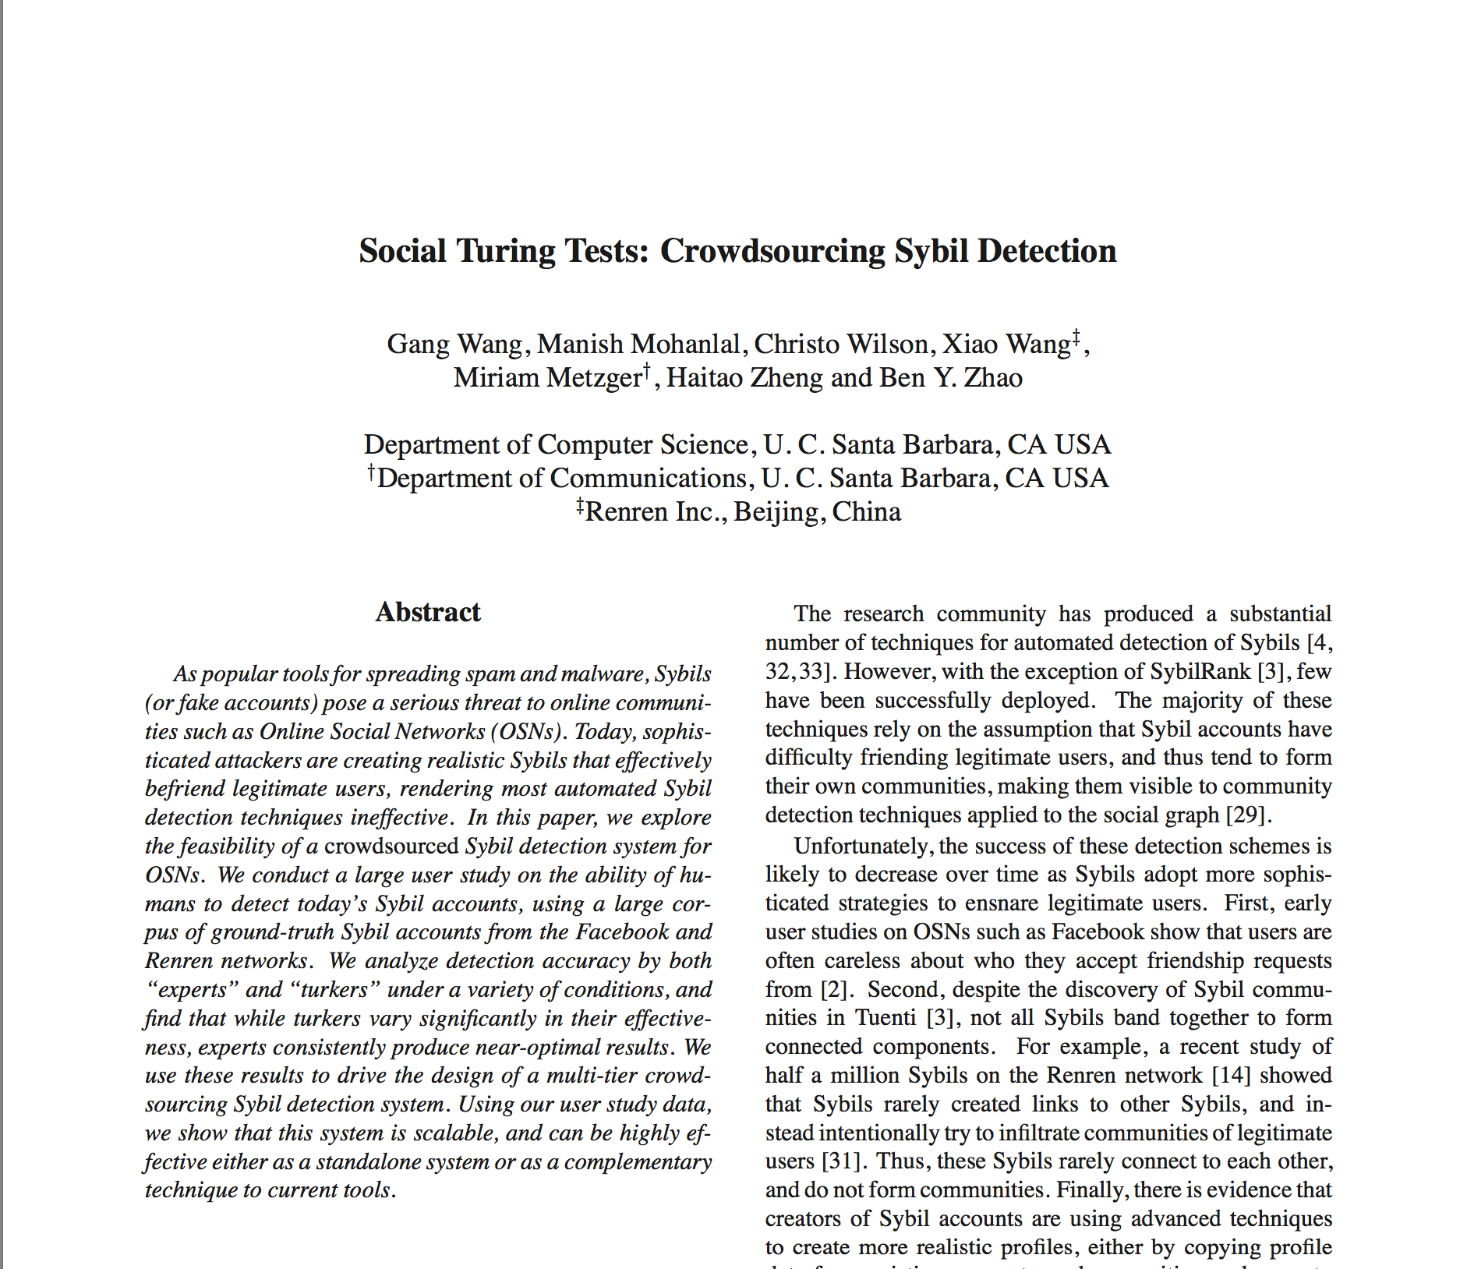
User Study Setup*
User study with 2 groups of testers on 3 datasets
2 groups of users
Experts – Our friends (CS professors and graduate students)
Turkers – Crowdworkers from online crowdsourcing systems
3 ground-truth datasets of full user profiles
Renren – given to us by Renren Inc.
Facebook US and India – crawled
Sybils profiles – banned profiles by Facebook
Legitimate profiles – 2-hops from our own profiles
Data collection details
*IRB Approved

Slide 10
Real or fake?
Why?
Classifying
Profiles
Navigation Buttons
Browsing
Profiles
Screenshot of Profile
(Links Cannot be Clicked)

Slide 11
Experiment Overview
Dataset | # of Profiles |  | Test Group | # of Testers | Profile per Tester
 | Sybil | Legit.
Renren | 100 | 100 | Chinese Expert | 24 | 100
 |  |  | Chinese Turker | 418 | 10
Facebook US | 32 | 50 | US Expert | 40 | 50
 |  |  | US Turker | 299 | 12
Facebook India | 50 | 49 | India Expert | 20 | 100
 |  |  | India Turker | 342 | 12
More Profiles per Experts

Slide 12
Individual Tester Accuracy
Much Lower Accuracy
Experts prove that humans can be accurate
Turkers need extra help…
Excellent!
80% of experts have >80% accuracy!

Slide 13
Wisdom of the Crowd
Is wisdom of the crowd enough?
Majority voting
Treat each classification by each tester as a vote
Majority vote determines final decision of the crowd
Results after majority voting (20 votes)
Both Experts and Turkers have almost zero false positives
Turker’s false negatives are still high
US (19%), India (50%), China (60%)
False positive rates are excellent
What can be done to improve turker accuracy?

Slide 14
Eliminating Inaccurate Turkers
Dramatic Improvement
Removing inaccurate turkers can effectively reduce false negatives!

Slide 15
Outline
Introduction
User Study
Scalable Sybil Detection System
System Design
Trace-driven Simulation
Conclusion

Slide 16
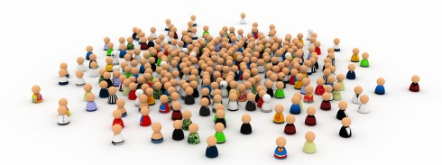
A Practical Sybil Detection System
Scalability
Must scale to millions of users
High accuracy with low costs
Preserve user privacy when giving data to turkers
Details in Paper
Key insight to designing our system
Accuracy in turker population highly skewed
Only 10% turkers > 90% accurate
CDF (%)
Accuracy (%)

Slide 17
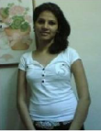
System Architecture
Maximize Utility of
High Accuracy Turkers
Crowdsourcing Layer
Rejected!
OSN Employees
Very Accurate
Turkers
Turker
Selection
Accurate Turkers
Sybils
All Turkers
Continuous Quality Control
Locate Malicious Workers
Heuristics
Social Network
User Reports
Suspicious Profiles
Flag Suspicious Users

Slide 18
Trace Driven Simulations
Simulation on 2000 profiles
Error rates drawn from survey data
Calibrate 4 parameters to:
Minimize false positives & false negatives
Minimize votes per profile (minimize cost)
Very Accurate
Turkers
Accurate Turkers
Results (Details in Paper)
Average 6 votes per profile
<1% false positives
<1% false negatives
Results++
Average 8 votes per profile
<0.1% false positives
<0.1% false negatives

Slide 19
Estimating Cost
Estimated cost in a real-world social networks: Tuenti
12,000 profiles to verify daily
14 full-time employees
Annual salary 30,000 EUR* (~$20 per hour) → $2240 per day
Crowdsourced Sybil Detection
20sec/profile, 8 hour day → 50 turkers
Facebook wage ($1 per hour) → $400 per day
Cost with malicious turkers
25% of turkers are malicous
$504 per day
Augment existing automated systems
*http://www.glassdoor.com/Salary/Tuenti-Salaries-E245751.htm

Slide 20
Conclusion
Designed a crowdsourced Sybil detection system
False positives and negatives <1%
Resistant to infiltration by malicious workers
Low cost
Currently exploring prototypes in real-world OSNs

Slide 21
Questions?
Thank you!

