Slide 1

Whispers in the Dark: Analysis of an Anonymous Social Network
IMC’14
Gang Wang, Bolun Wang, Tianyi Wang, Ana Nika,
Haitao Zheng, Ben Y. Zhao
UC Santa Barbara
gangw@cs.ucsb.edu

Slide 2





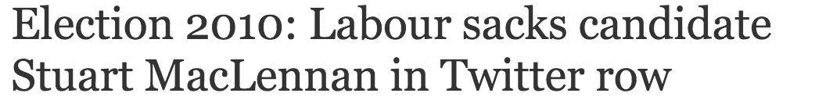

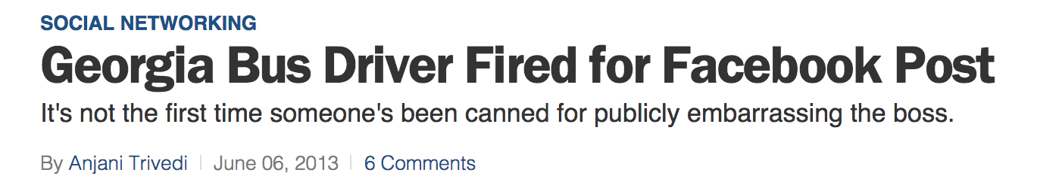
Concerns of Using Online Social Networks
Users cannot speak freely in online social networks
  User profile is linkable to real-world identity
  Online actions can cause serious consequences

Slide 3






Whisper Anonymous Social Network
Whisper, an anonymous social app
  Online profile unlinkable to real identity
  Express freely without fear of retaliation or abuse
    Share stories, seek advice, express complaints
    Whistleblowers, teenagers avoiding bully
  Interact with people anonymously
  > 3 billion monthly page views, 2014
Part of wave of new, anonymous social networks
  SnapChat, Secret, Yik-yak, Wickr, Rooms (Facebook)

Slide 4




Key Features
No personally identifiable information
  No real names, only nicknames
  No user profiles (phone#/email)
  No explicit social links
  Moderate content to make sure users
  don’t reveal their identity
Post whisper messages
  Topics including relationships, family,
  work, religion, politics, sex, etc.
  Secrets, confessions
3

Slide 5
Our Goals
Understand how anonymity affects user behavior in anonymous social networks
  How is Whisper’s network structure different from existing networks like Facebook and Twitter?
  How does anonymity impact the friendships between users and user engagement over time?
  Implications on user anonymity and privacy

Slide 6
Outline
Motivation
Dataset and Whisper Network
  Data Collection
  Basic Network Structure
User Engagement and Stickiness
Anonymity and Privacy in Whisper
Conclusion

Slide 7
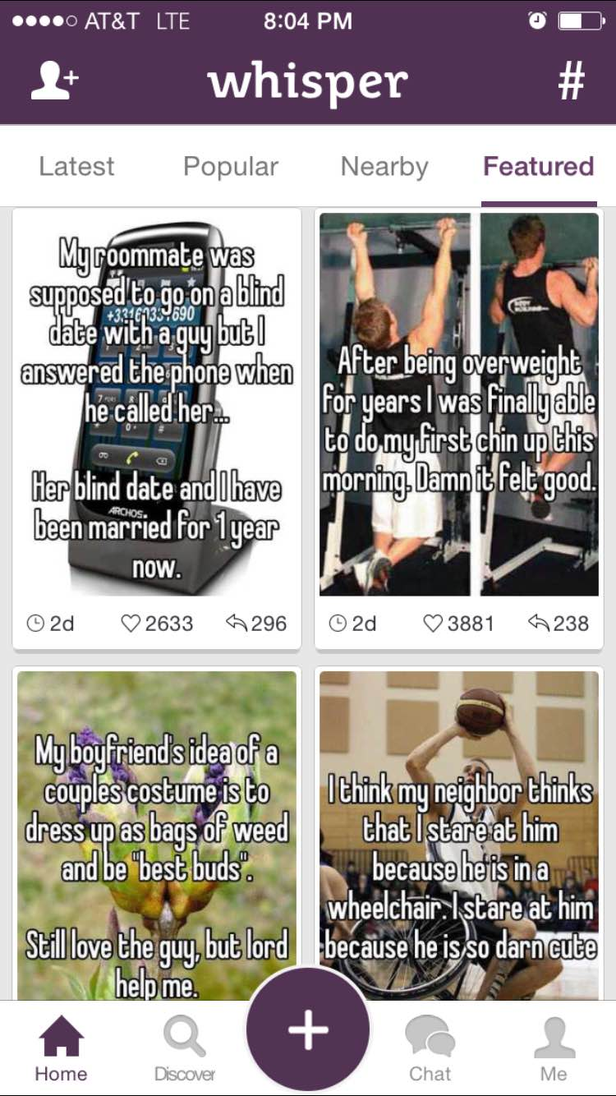

Whisper Functions and Data
Nickname and a (rough) location
System-wise recent whispers
Public whisper lists
Latest: all recent whispers in the network
Nearby: whispers in local area < 40 miles
Popular: whispers received many replies
Featured: editor-picked whispers
Whisper and replies are public data;
Chatting is private

Slide 8

Data Collection
Crawled the “latest whisper” stream for 3 months*
  All public messages from February to May 2014
  9,343,590 original whispers, 15,268,964 whisper replies
  1,038,364 unique userIDs
Interacted frequently with Whisper
  In-person meetings to get data collection permission
  Whisper removed GUID in June 2014
Global universal identifier (GUID) ➔
Link the same user’s data over time
*Data collection with Whisper’s permission, IRB approved

Slide 9
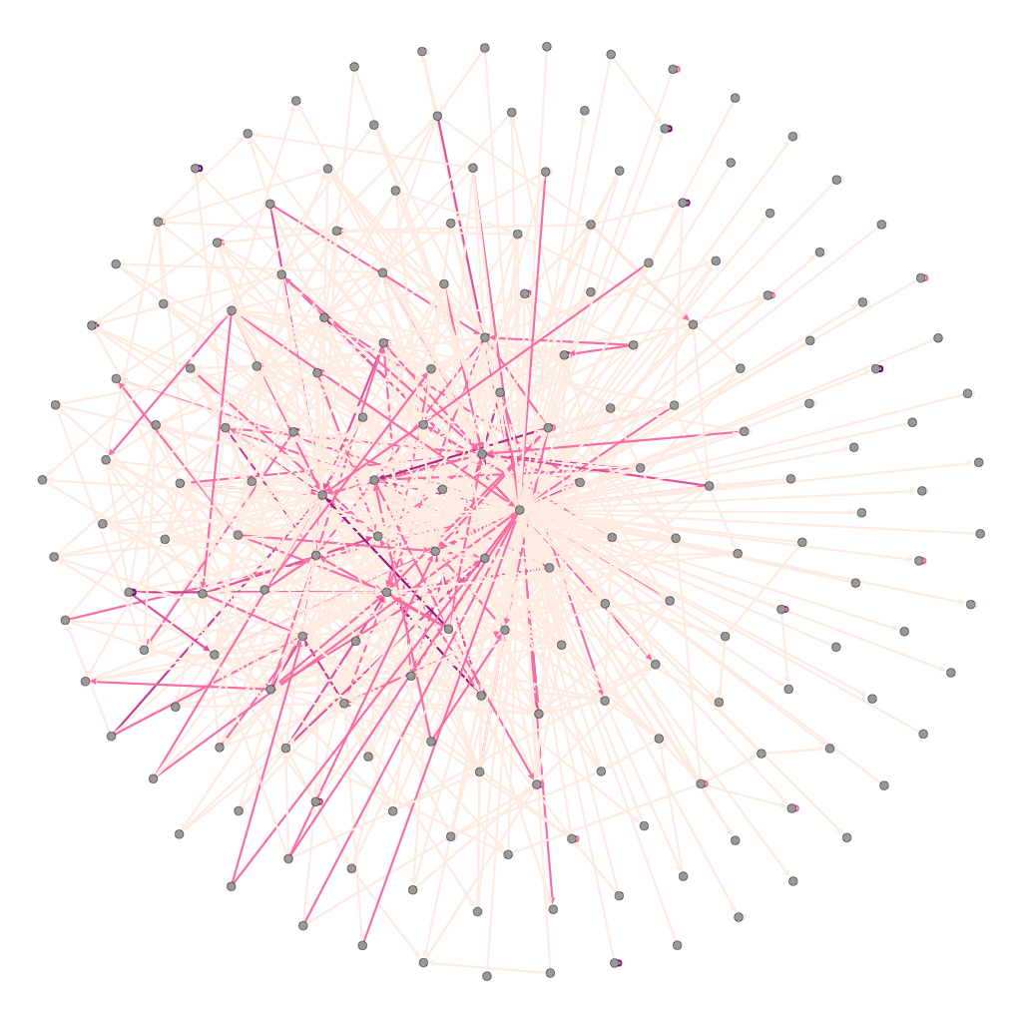
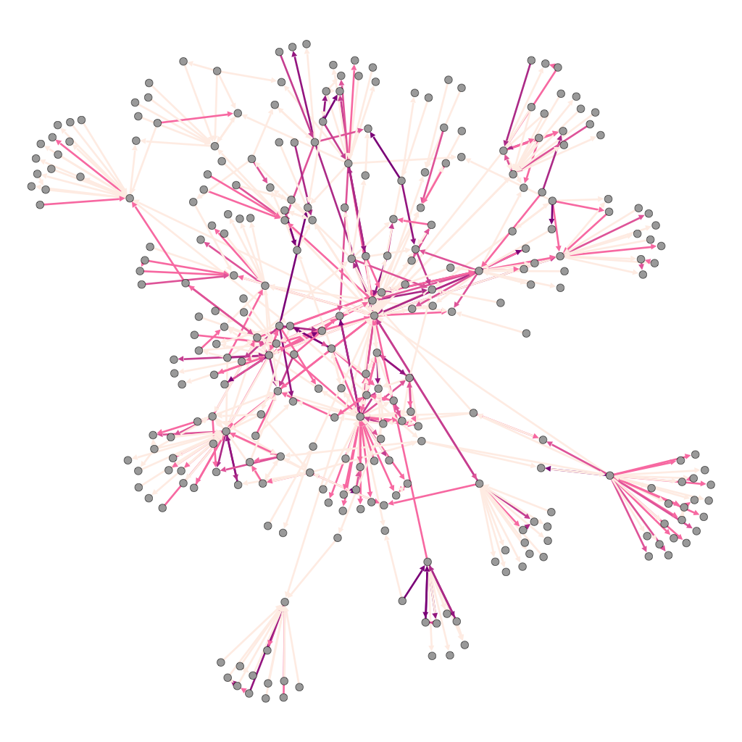
Basic Analysis: Interaction Graph
Whisper graph has high dispersion
Interact with a wide range of strangers
How do users interact with each other with no explicit social links?
Interaction graph: Whisper vs. Facebook and Twitter
  Users are nodes, edges represent user interaction
  3-month time window for all three graphs
Existing social networks:
Interact with a fixed set of friends
VS.
Whisper
Graph | Interact. Event | Nodes | Edges | Avg. Degree | Clustering Coefficient | Avg. Path Length | Assort.
Whisper | Replies | 690K | 6531K | 9.47 | 0.033 | 4.28 | -0.011
Facebook | Wall Posts | 707K | 1260K | 1.78 | 0.059 | 10.13 | 0.116
Twitter | Retweets | 4,317K | 16972K | 3.93 | 0.048 | 5.52 | -0.025
Facebook

Slide 10
Persistent Friendship
Persistent user pairs (strong ties) are extremely rare
  Only 7.7% user pairs interacted multiple times (out of all edges)
  Majorities are weak ties, talked once, never again
  Lower bound of user interactions (no data on private messages)
Majority of user-pairs have weak relationships:
short-lived, with few interactions
Number of Total Interactions
Time Between First and Last Interaction (Days)

Slide 11
Do Communities Exist?
Community detection on Whisper interaction graph
  Modularity-based approaches: Louvain and Wakita
  Resulting modularity: Louvain (0.492), Wakita (0.409)
Modularity > 0.3 ➔ community structure
  Facebook (0.63), Youtube (0.66), Orkut (0.67) [IMC’09]
  Whisper has weak community structures
Even though users don’t have persistent friends, they still form communities

Slide 12
Why Do Users Form Communities?
Intuition: users interact with nearby users (via nearby list)
Validation: whether community membership correlates with geographic location
  Example community of 28,342 users, its top 4 regions are
    California (62%), Texas (1.5%), England (1.2%), Arizona (0.9%)
Users within a community likely from the same region
Percentile of Communities | 1st Region | 2nd Region | 3rd Region | 4th Region
50-percentile | 52% | 3.9% | 1.5% | 1.4%
70-percentile | 45% | 1.4% | 1.3% | 1.3%
90-percentile | 32% | 0.9% | 0.9% | 0.8%
Users form communities based on geolocation

Slide 13
Outline
Motivation
Dataset and Whisper Network
User Engagement and Stickiness
  User Engagement Over Time
  Predicting Future Engagement
Anonymity and Privacy in Whisper
Conclusion

Slide 14

From Network Ties to User Engagement
Background: social ties impact network “stickiness”
  Strong ties: close friends, weak ties: strangers
  Strong ties help keep existing users from leaving
  ➔ a more “sticky” network
Our question: with a network of strangers, how well can Whisper maintain user engagement over time?
Evaluate per-user engagement over time
  How long do users stay active?
  Do users turn dormant quickly?
stranger

Slide 15
How Long Do Users Stay Active?
User’s active period (normalized)
  “Active” means users still generate new content
  User’s active period / our monitoring period of that user
Significant portion of users quickly turn dormant
Bimodal distribution ➔ predict users stay or not?
Users who stayed active
Users who were only active for the first1-2 days (~35%)

Slide 16
Predicting User Engagement
Binary prediction, whether disengage quickly or not
  Input: user’s data during initial X days
  ML classifiers: Random Forest, SVMs, Bayes, Decision Tree
Features (20)
  Content posting volume, frequency (7)
  Social interactions (8)
  Temporal features (2)
  Activity trend (3)
A extensive list of features, can be further trimmed

Slide 17
Prediction Result (Random Forest)
Top 4 Features produce accurate results
# of days with > 1 whisper
# of days with > 1 reply
Is posting volume decreasing?
# of total posts
10-fold cross validation on ground-truth dataset
  Classify users using their first X days of data
1-day data already has 75% of accuracy
94% Accuracy when predicting engagement
Whisper can identify users likely to leave
Increase user engagement using other tools
16

Slide 18
Outline
Motivation
Dataset and Whisper Network
User Engagement and Stickiness
Anonymity and Privacy in Whisper
Conclusion

Slide 19


Privacy and Anonymity in Whisper
Existing mechanisms to prevent PII leakage
  No personal information is collected (no real name, phone# or email address)
  Server only stores public whispers, private chats stay on the phone
  Noise is added to user GPS before sending to Whisper’s servers
Worst case: attacker compromises servers and obtains data
  Much more external data needed to de-anonymize users
Whisper
?

Slide 20
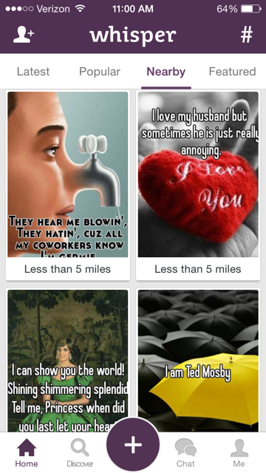
Location Tracking Attack
Tracking whisper users’ locations
  Pinpoint current location: error < 0.2 miles
  Allow attackers to follow (stalk) users
How to attack
  “Nearby list” shows whispers by distance
  Triangulate user location using distance measurements
  Reverse-engineer Whisper’s noise function
Key problem: lack of GPS authentication
  Unlimited # of queries from any location (fake GPS input)
  Use statistics to overcome noise

Slide 21
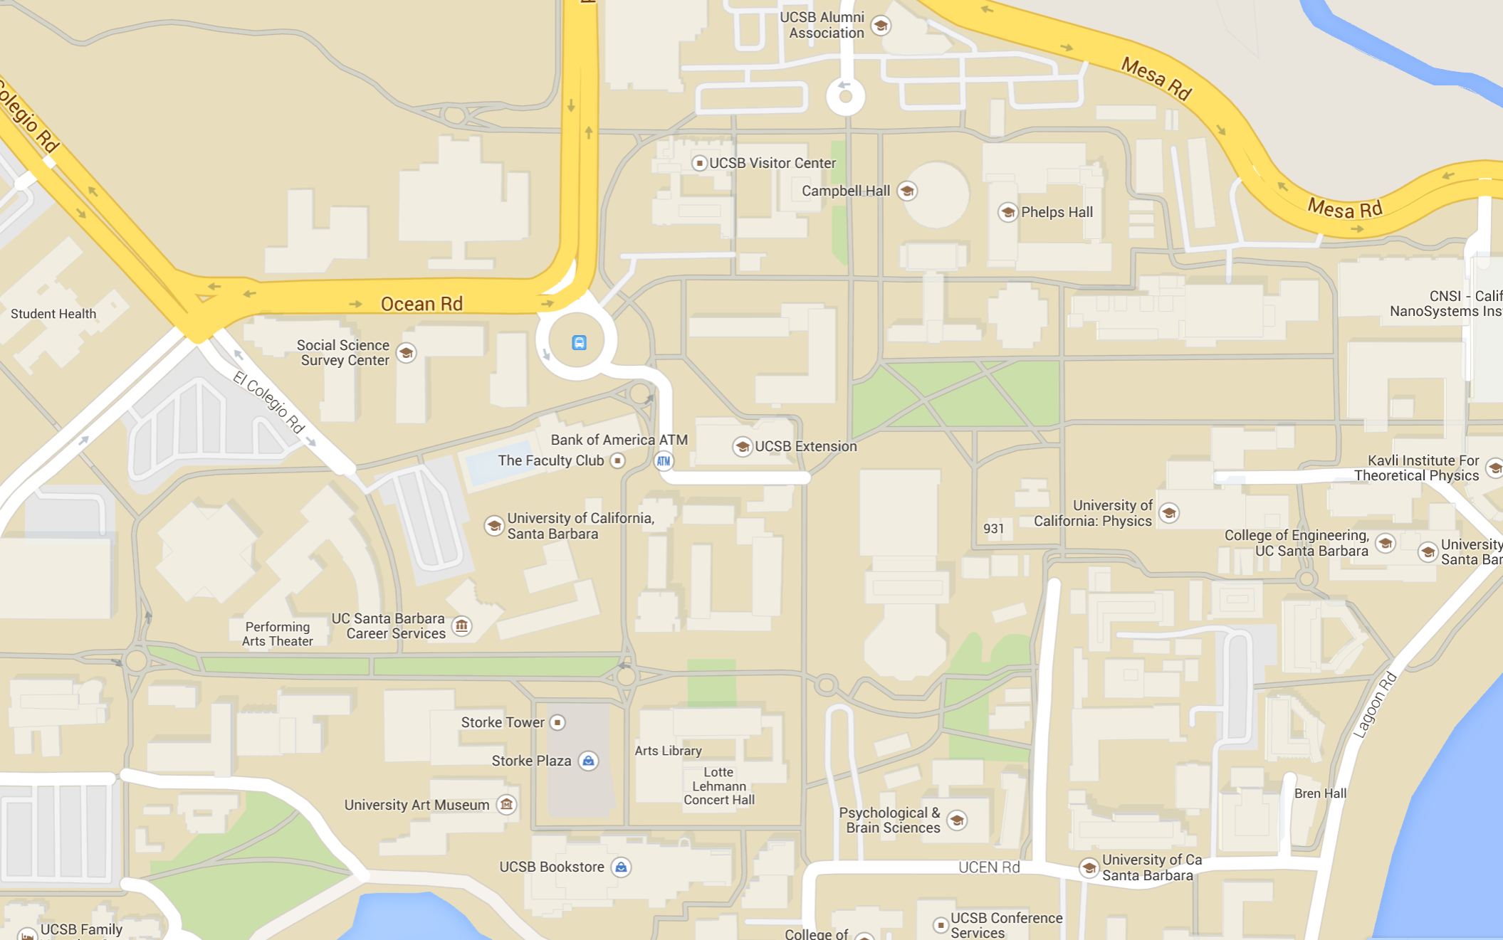

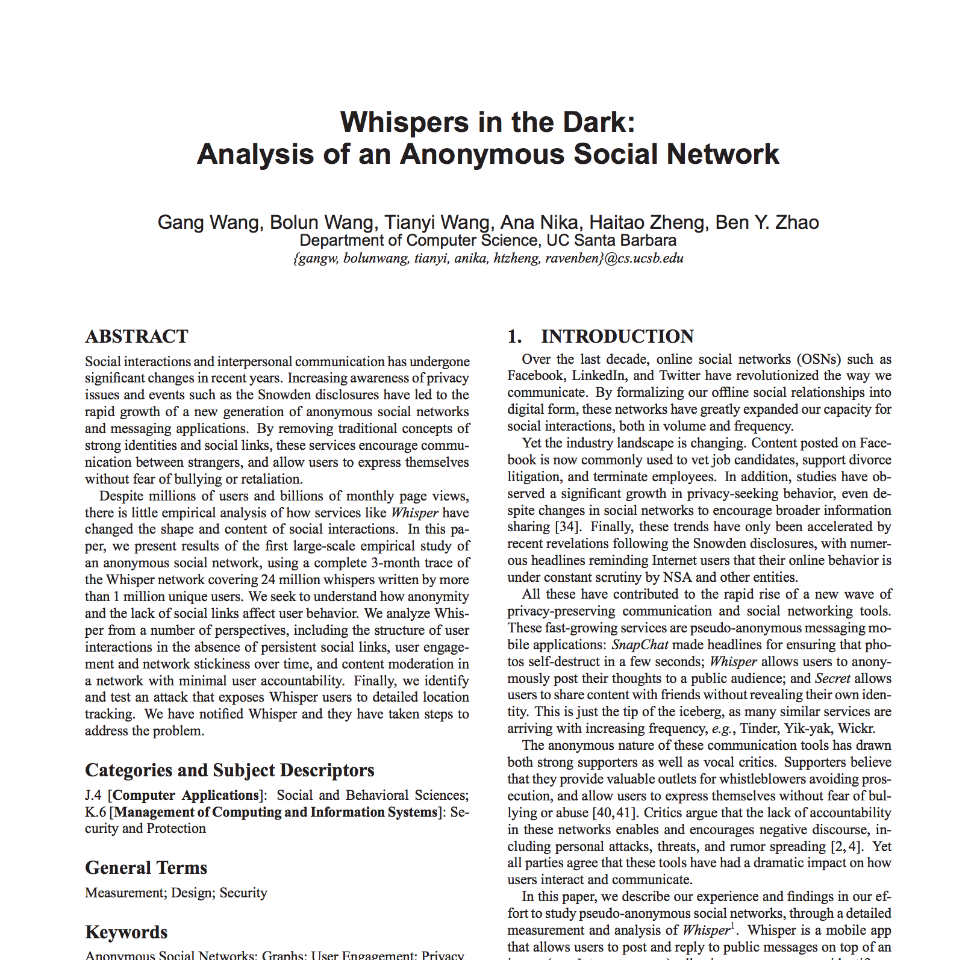
An Example Attack
Attack fully automated with forged GPS
Query “distance” to the victim
Navigate to victim step by step until convergence
Whisper: “Get more beer!”
Whisper: “BZ is away in Dublin, party in the lab!”
Triangulate target location!
Attacker
Location converged!
Victim
Distance Query
More Details
Fixed by Whisper

Slide 22
Summary
The first large-scale measurements on Whisper
User interaction has high dispersion, difficult to build persistent friendship
User engagement shows bimodal distribution, future engagement can be predicted by early-day data
Anonymous apps can still leak personal information
  Location: once shared with the app, has the risk of leaking
  No reliable GPS authentication, attacker can query any locations

Slide 23

Thank You!
Questions?

Slide 24
References
  [COSN’13] GARCIA, D., MAVRODIEV, P., AND SCHWEITZER, F. Social resilience in online communities: The autopsy of friendster. In Proc. of COSN (2013).
  [IMC’09] KWAK, H., CHOI, Y., EOM, Y.-H., JEONG, H., AND MOON, S. Mining communities in networks: a solution for consistency and its evaluation. In Proc. of IMC (2009)

