Slide 1
Crowds on Wall Street: Extracting Value from Collaborative Investing Platforms
Gang Wang, Tianyi Wang, Bolun Wang, Divya Sambasivan
Zengbin Zhang, Haitao Zheng, Ben Y. Zhao
UC Santa Barbara
gangw@cs.ucsb.edu

Slide 2
For most of us,
key to building personal wealth is INVESTMENTS

Slide 3
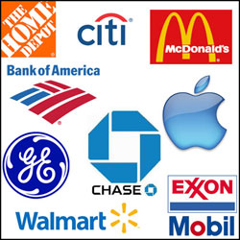
Investing in Stocks
Stock: owning a piece of a public company
Buy/sell on public markets (e.g. NYSE)
Price of shares can be highly volatile
Market fluctuations
Company earnings, new products
News, rumors …
Effective long term investment vehicle
Benchmark index: S&P 500 Returned 9.84% compounded (1965-2014)

Slide 4
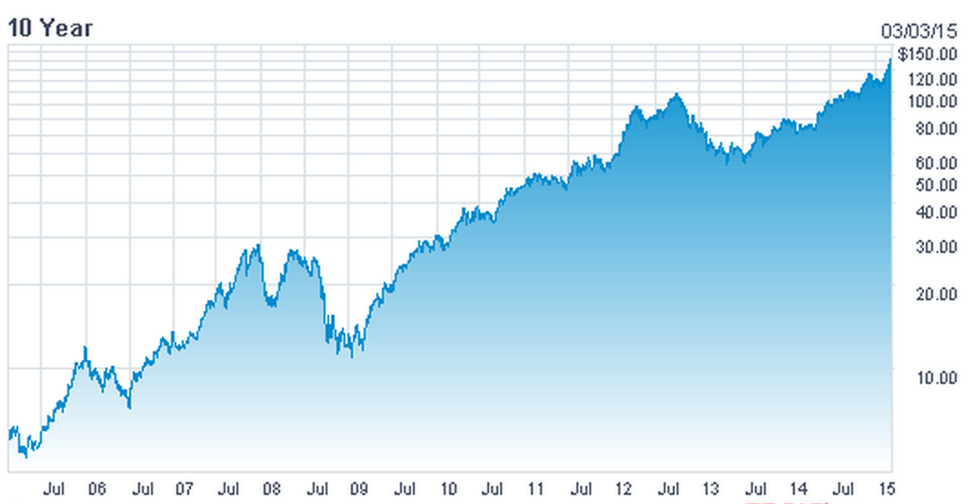
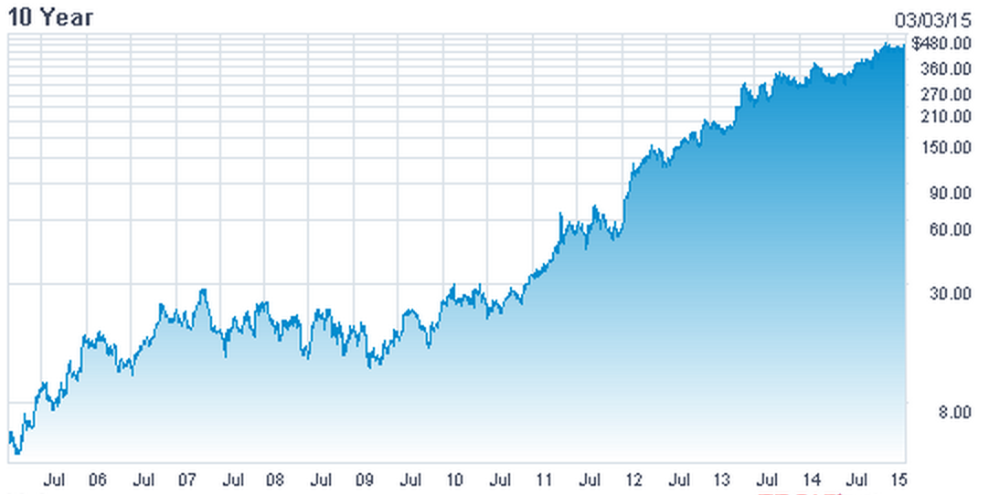
Stocks: the Good …
March 2005: $6.01
March 2015: $129.25
$10,000 → $215,000
March 2005: $5.11
March 2015: $428.95
$10,000 → $839,000

Slide 5
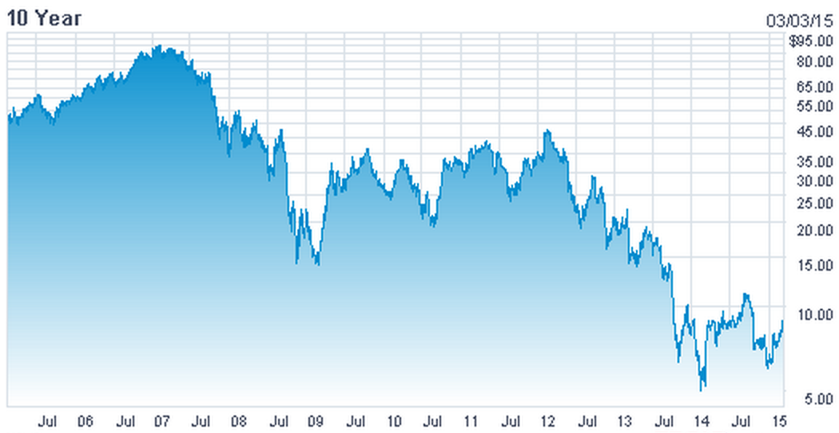
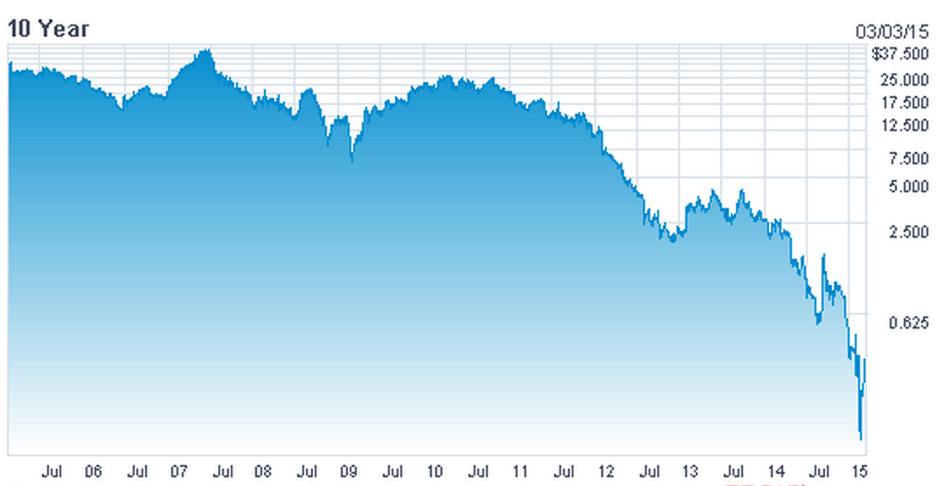
and the Not so Good
March 2005: $51.05
March 2015: $7.72
Loss of 84.8%
March 2005: $29.73
March 2015: $0.22
Loss of 99.26%

Slide 6
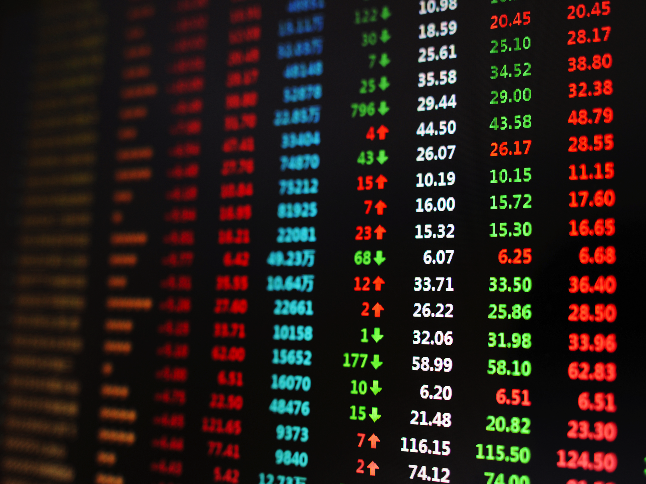
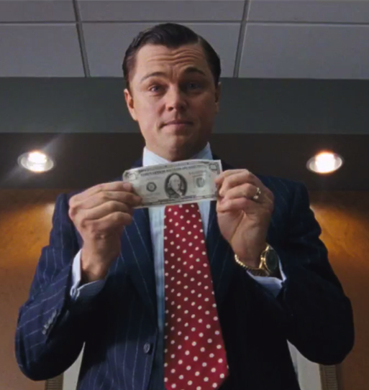
What should I buy?
I need an Oracle…

Slide 7
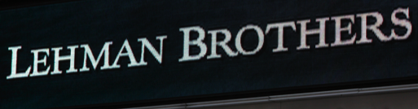
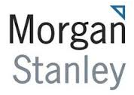
Investment Advisors
1850
1869
1895
1914
1923
1935
1949 Birth of the hedge fund
2000+ Rapid growth in industry
2014 2.48 Trillion USD$ under management
2000+

Slide 8
A New Trend…
Crowdsourcing is changing the industry…

Slide 9
Collaborative Investing Platforms
Crowdsourcing for stock investment
Instead of paid experts, stock analysis from individual contributors (paid by article views)
Independent investors, analysts, market newcomers
“Free” ad-supported model
3 million users, 8 million monthly views
300,000 users, 40 million online users

Slide 10
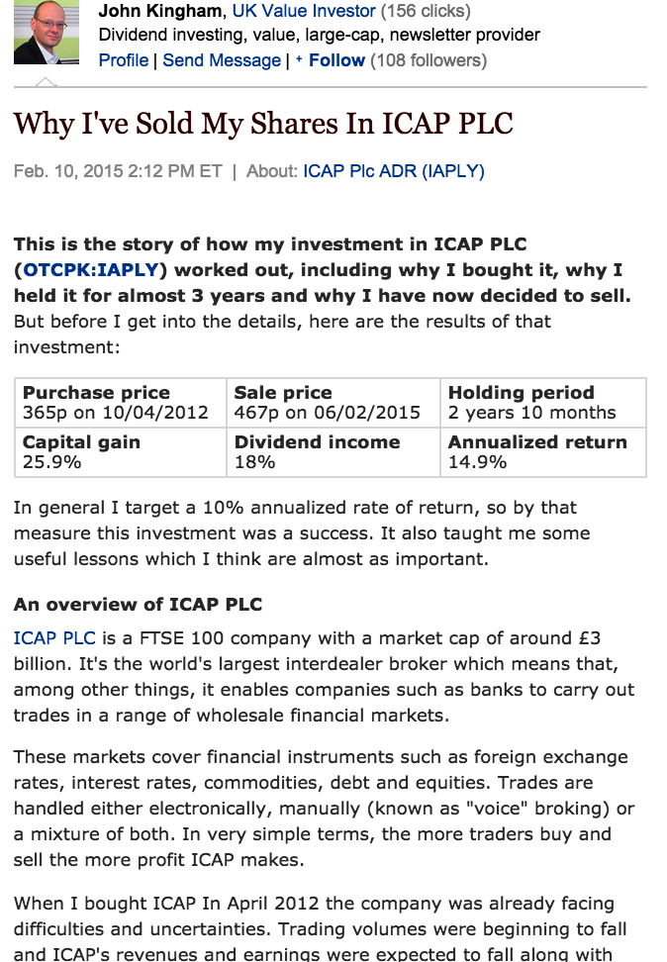
Expert vs. Peer-based Models
Professional Investor
Stock
SeekingAlpha (SA): expert model
Long articles with in-depth analysis
Only 2% of users are contributors (authors)
Majority of users are consumers only
StockTwits (ST): peer model
Any user can contribute an opinion
Short text < 140 characters

Slide 11
Key Questions
Is there real value in articles on collaborative investment platforms?
Notoriously difficult industry
Can we replace years of Wall Street experience with opinions from an anonymous crowd?
Can crowd predict stocks movement?
The answers of course, are in the data!
Are some Experts more Expert than others?
If so, how do we find the true experts?

Slide 12
Datasets
SeekingAlpha
Complete dataset of all articles
9 years worth, crawled in April 2014
StockTwits
Complete dataset of all Twits
4 years of messages from StockTwits Inc.
Site | Time Range | Total Posts | Active Users | Authors | Stocks
SeekingAlpha | 2004-2014 | 410,000 | 228,000 | 8783 | 10400+
StockTwits | 2009-2014 | 12 Million | 86,000 | 86,000 | 9300+

Slide 13
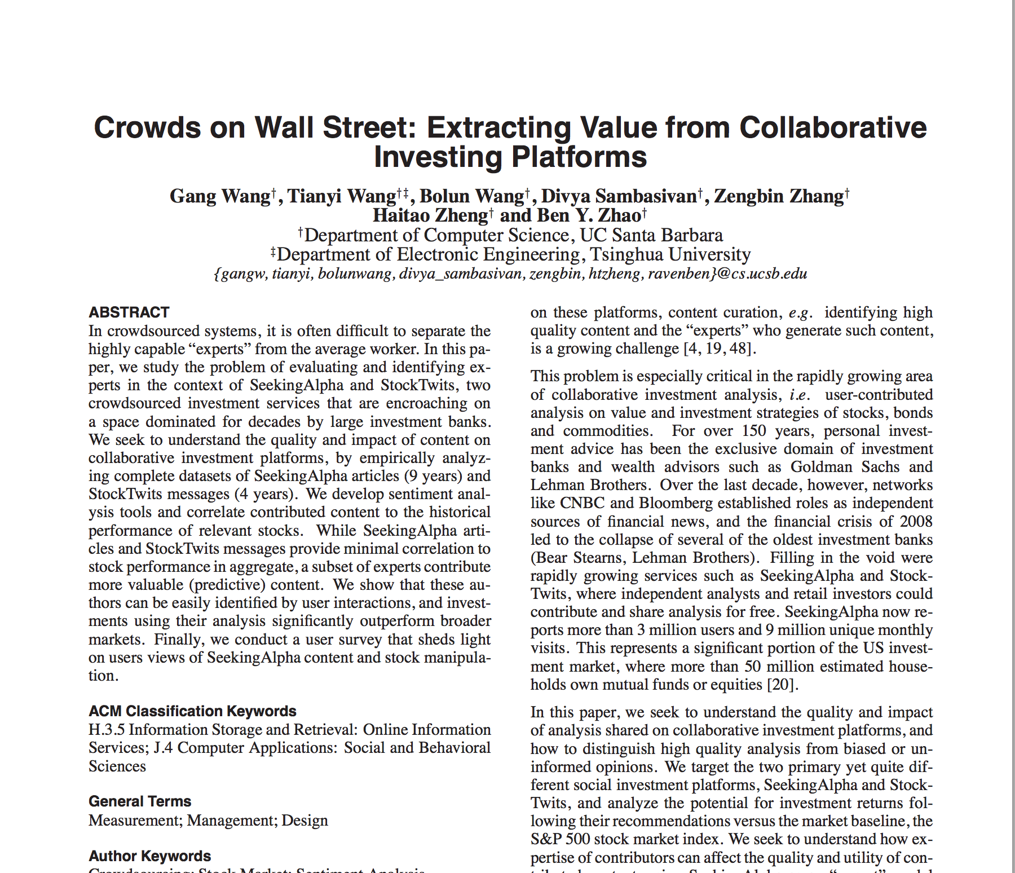
Sentiment vs. Stock Price
Can article sentiment predict stock price movement?
Go back in time, analyze each article & compare to stock performance
Pearson correlation: sentiment vs. future stock price
1 (-1): strong positive (negative) correlation
0: no correlation
$
Stock
Stock
$
Stock
Our sentiment classifiers
SA articles: 85.5% accuracy
ST message: 76.2% accuracy
Details Here

Slide 14
Aggregate Correlation Results
(Let’s look at community-wide sentiment first…)
SeekingAlpha
Very weak correlation!
0.05 ➔ prediction accuracy 53%
Oops! No wisdom in the crowd for this domain!
StockTwits
Also weak correlation
Even negative correlation (30 days)

Slide 15
Any Experts in the Room?
Are all authors equally bad, or is there signal in the noise?
Rank authors based on historical predictions, pick top authors (e.g., top 100 author at year 2013 )
Much stronger correlation!
Top authors: 0.4 ➔ accuracy 75%
vs.
All authors: 0.05 ➔ accuracy 53%
Q1: How do we find the “experts”?
Q2: Is past performance indicative of future performance?

Slide 16
How to Identify Experts?
(Two possible approaches)
Based on authors’ previous prediction performance
Average prediction accuracy per stock
But gathering all statistics is non-trivial
Instead: try authors’ interactions with the crowd
Total # of posted comments over all articles
Average # of comments per article
Let’s try both!!

Slide 17
Sentiment-based Trading
Hold or sell stocks based on experts’ sentiment
Maintain a portfolio of 500 stocks
Trade stocks weekly, update top authors annually
Trade weekly based on last-week sentiment
If positive ➔ hold
Else ➔ sell shares
MSFT, AAPL, …
MSFT, AAPL, …
500 Stocks from experts, Gain: 0%
500 Stocks from experts, Gain: 12.1%
Experts
(Last Year)
Repeat this every year
Accumulate stock return
. . .
January
2015
December
. . .
Started
Update Experts and Stocks

Slide 18
Trading Strategy: SeekingAlpha
Our
Strategies
108% return over 8 years,
Consistently outperform S&P500 (40%)
“Total-comments” is the most effective metric to identify experts
Baseline: buy and hold S&P500,
a widely used market baseline
S&P500
Small set of “experts” produces high quality content
Those experts can be identified by the rest general crowd
Eurozone Debt crisis
Fiscal Crisis
2006 2007 2008 2009 2010 2011 2012 2013 2014

Slide 19
Trading Strategy: StockTwits
Still high return (30%-40%), but below S&P500 baseline
Unsurprising, since following the crowd always a bad strategy
2010 2011 2012 2013 2014

Slide 20
Conclusion and Ongoing Work
Key Insights
Only a small set of experts can accurately predict stock price
2nd order wisdom of the crowd: general crowd cannot predict stock movements, but can help to identify those who can
User survey on experiences w/ manipulative articles
Simple trading strategy significantly outperforms market baseline over 8 years
Site running our stock mining and recommendations in real time http://hotcrp.cs.ucsb.edu:88
Ongoing work: detecting/combating stock manipulation

Slide 21
Thank You! Questions?
http://sandlab.cs.ucsb.edu

